Slide 1
Project 9: EKF-based Localization with LRF
Presentation 1:
Task, Theory and Approach

Slide 2
Outline
Task
Extended Kalman Filter
Problem Solving Approach
Conclusion
??? Questions ???

Slide 3
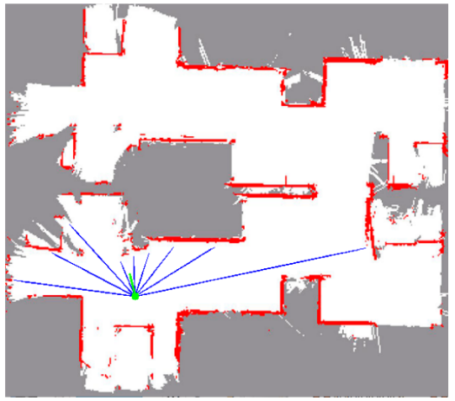
Task
Goal: estimate location & orientation in real time
Method:
Implement an EKF
Use odometry for prediction
Compare LRF measurements with map- based expected measurements for updates
Use SLAM package for obtaining the map
Implement robustness to kidnapping and global localization

Slide 4
Extended Kalman Filter (1)
Update
Prediction
Matching/
Filtering
Algorithm to achieve relative and absolute localization
Three staged recursive process
Depends on the previous knowledge ot the enviroment
Sensitive to initial estimate or modelling errors

Slide 5
Extended Kalman Filter (2)
Update
Prediction
Matching/
Filtering
EKF updates knowledge of world map using
Obtained observations
New position

Slide 6
Extended Kalman Filter (2)
Update
Prediction
Matching/
Filtering
Two mathematical steps
Combination of odometry predicted and observation model estimate

Slide 7
Extended Kalman Filter (3)
Update
Prediction
Matching/
Filtering
Match prediction with observations at new state
Avoids miscalculations
If matching is successful state and world map is updated

Slide 8
Problem Solving Approach (1)
Mapping the room
Combine pre-acquired map with the mapped room
Implement EKF
Optimize the problem

Slide 9
Problem Solving Approach (1)
Mapping: robot needs to describe the enviroment
Geometric
Describe environment in metric terms without considering landmarks
Problems:
Detect object through sensors
Understand provided information
Find a computationally inexpensive model
Odometry can be inaccurate due to wheel slippage
Noises from mirrors
Topologic
Describe environment in terms of certain features in specific locations and ways from going from one location to another

Slide 10
Conclusion
???
???
???

Slide 11
??? Questions ???
???
???
???

